Slide 1
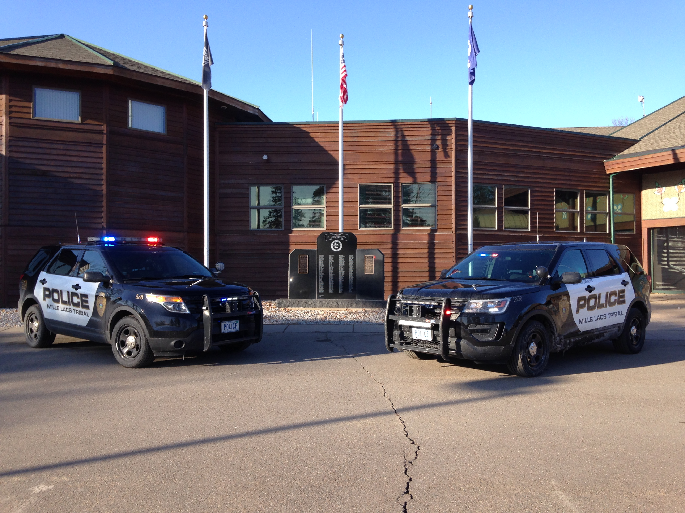
Mille Lacs Tribal Police Department
Dedicated to Service

Slide 2
Why Work for the Mille Lacs Tribal Police?
Mille Lacs Tribal Police is a POST licensed agency with 23 Officers
  As with any other POST licensed agency, Officers are required to maintain 48 continuing education credits every three years to maintain their Peace Officer license
In addition to monthly Patrol Online courses, Officers are provided with ample amounts of training opportunities
The majority of the Mille Lacs Band Tribal Police Officers currently hold a Federal Deputation through the Bureau of Indian Affairs (BIA) allowing Officers to submit cases to the U.S. Attorney for Federal Prosecution on certain crimes

Slide 3
Why Work for the Mille Lacs Tribal Police?
(cont.)
The Mille Lacs Tribal Police have a “take home car” policy, allowing Officers to take their respective patrol vehicles home up to 40 miles away from their respective District
Officers & the Department pay into the Public Employee Retirement Association (PERA) Police & Fire Plan
22 Paid Holidays Per Year
Full Benefits Package With the Option of Medical, Dental, Eye, and Life Insurance
Paid Weekly

Slide 4
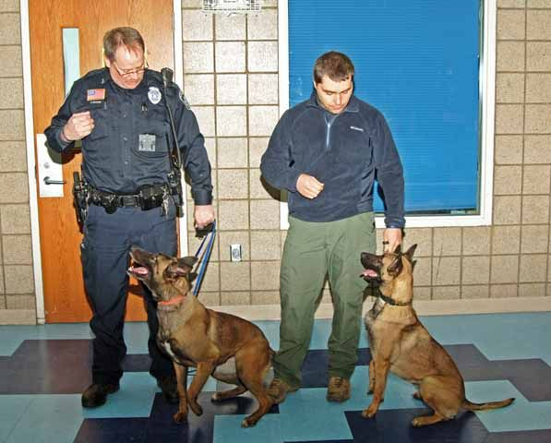
Why Work for the Mille Lacs Tribal Police?
(cont.)
Various Specialty Units/Details Officers Have the Opportunity To Work (not an inclusive list):
  K-9 Unit
  SWAT
  Investigations
  Drug Task Force/Drug Interdiction
  Patrol Officers Used in Various Sting
  Operations
  Intoxilyzer Operator
  Firearms
  Defensive Tactics
  Taser

Slide 5
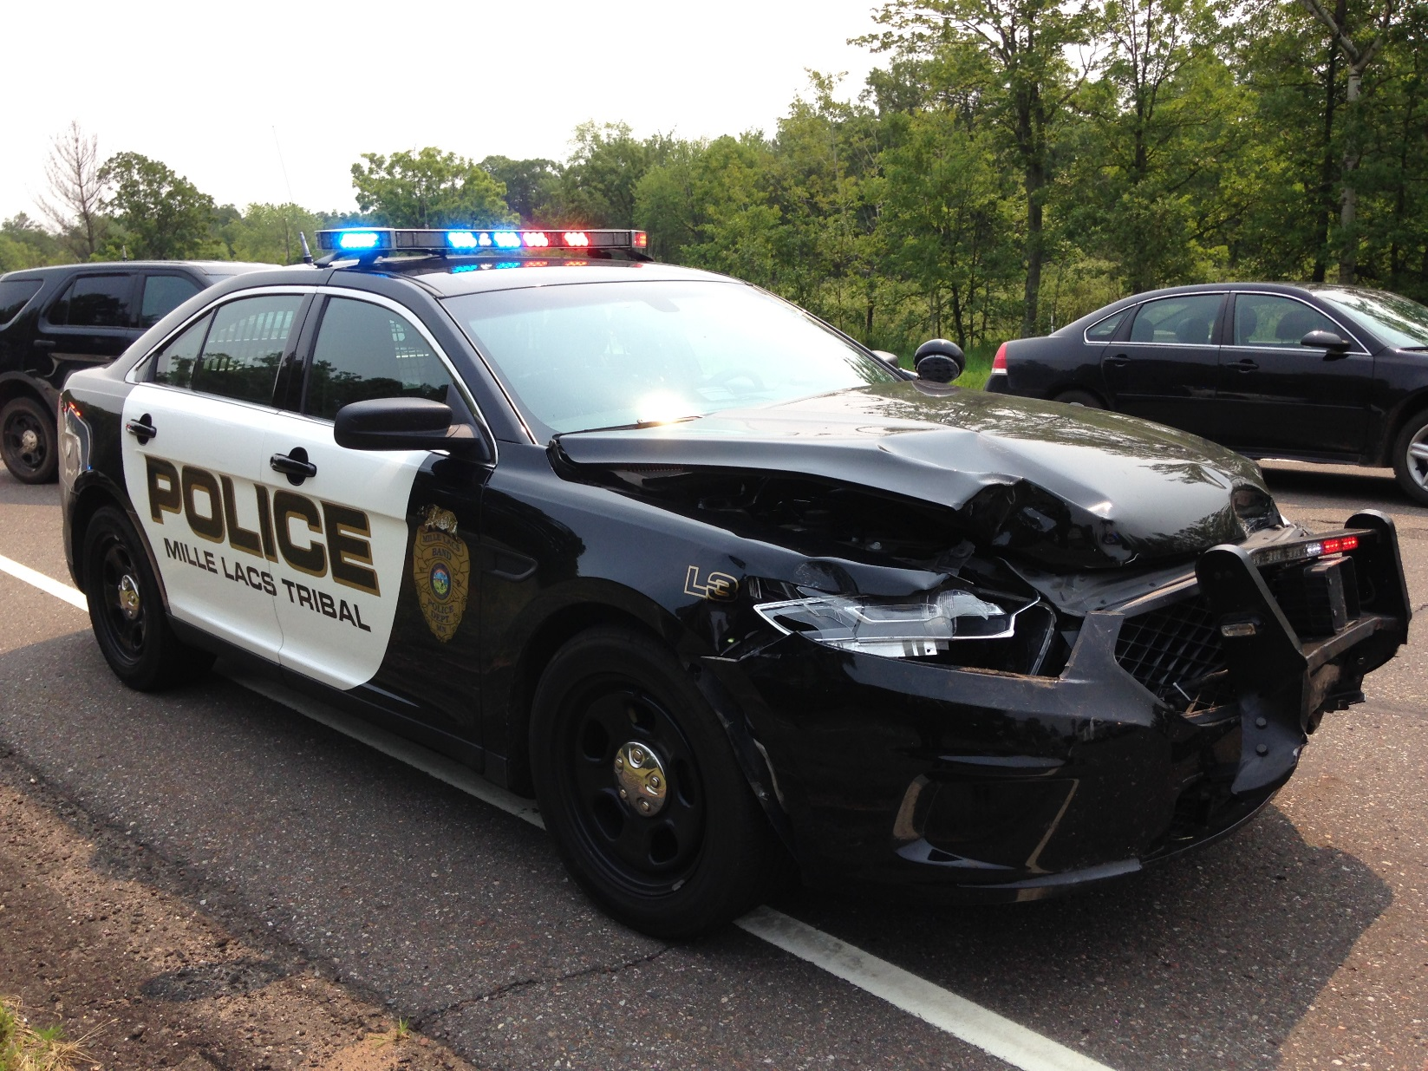
All Officers Attend the BIR Emergency Vehicle Operation Course and get PIT (Pursuit Immobilization Technique) Certified

Slide 6
Great Equipment
All Officers Are Certified in Utilizing the Stinger Spike Strips
Remington 870 Less Lethal Shotgun & X26/X26P Tasers
AR 15 Patrol Rifles with Aim Point Optic
Glock 22 Gen 4 with Tac Light
Department Intoxilyzer
  All Equipment is Individually Issued to Officers (example: Taser, Radio, PBT, Fingerprint Kit, Body Cameras, Crime Scene Equipment, iPhone, Toughbook MDT, etc…)

Slide 7
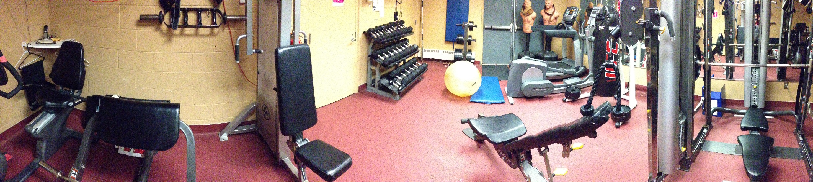
Why Work for the Mille Lacs Tribal Police?
(cont.)
Officers are allowed to work out 1 hour per shift as calls permit (paid)

Slide 8
Why Work for the Mille Lacs Tribal Police?
(cont.)
Overtime Opportunities:
  Hinckley Pow Wow
  Concerts/Events
  Covering Shifts
  Assignment Details

Slide 9
Why Work for the Mille Lacs Tribal Police?
Opportunities to work collaboratively with Bureau of Indian Affairs, Drug Enforcement Administration, Bureau of Criminal Apprehension, Bureau of Alcohol Firearms and Tobacco.
Work Collaboratively with Pine County Sheriff’s Office, Mille Lacs County Sheriff’s Office, Minnesota State Patrol.
A progressive Law Enforcement Agency with an excellent Field Training Program.

Slide 10
Why Work for the Mille Lacs Tribal Police?
(cont.)
All Initial Uniforms & Equipment Provided By the Department
Annual Clothing Allowance

Slide 11
Competitive Pay
Mille Lacs Tribal Police Officer
Starting $52,000 to $80,000

Slide 12
Other Comparable Departments
Grand Rapids (20 Sworn Officers): 10 year step program
  Starting Wage $40,227.20
  Top Wage $66,497.60
Hibbing (27 Sworn Officers): 5 Year Step Program
  Patrol - Starting Wage $46,238.40
  Patrol - Top Wage $50,939.20
Cloquet PD: 9 Year Step Program
  Starting Wage $45,489.60
  Top Wage $59,924.80

